Slide 1
SE2001
Software System Requirements
I. Introduction
Dr. Abdul Aziz
Department of Software Engineering
School of Computing
NUCES-(Fast) KHI
Monday, September 6, 2021

Slide 2
Course Objectives
Introduces process, methods and tools related to the software requirements engineering area.
Topics:
  Requirements elicitation
  Requirements analysis
  Requirements specification
  Requirements validation
  Requirements management
  Case studies
Monday, September 6, 2021

Slide 3
Course Work
Homework assignments (10)
Midterm (15 x 2 = 30)
Final exam (50)
Group project (10)
  A software requirements specification
  Team of two
Monday, September 6, 2021

Slide 4
Textbook
Gerald Kotonya and Ian Sommerville, Requirements Engineering: Processes and Techniques, John Wiley & Sons, 1998
Geri Schneider and Jason Winters, Applying Use Cases: A Practical Guide, Second Edition, Addison-Wesley, 2006
Monday, September 6, 2021

Slide 5
Chapter 1 Overview
To introduce the notion of system requirements and the requirements engineering process.
To explain how requirements engineering fits into a broader system engineering process
To explain the importance of the requirements document
Monday, September 6, 2021

Slide 6
System requirements
The requirements define the services that the system should provide and they set out constraints on the system’s operations
Define what the system is required to do and the constraints under which it is required to operate
Examples for a library system
  The system shall maintain records of all library materials including books, serials, newspapers and magazines, video and audio tapes, reports, collections of transparencies, computer disks and CD-ROMs.
  The system shall allow users to search for an item by title, author, or by ISBN.
  The system’s user interface shall be implemented using a World-Wide-Web browser.
  The system shall support at least 20 transactions per second.
  The system facilities which are available to public users shall be demonstrable in 10 minutes or less.
Monday, September 6, 2021

Slide 7
Types of requirements
Very general requirements which set out in broad terms what the system should do.
Functional requirements which define part of the system’s functionality.
Implementation requirements which state how the system must be implemented.
Performance requirements which specify a minimum acceptable performance for the system.
Usability requirements which specify the maximum acceptable time to demonstrate the use of the system.
Monday, September 6, 2021

Slide 8
Requirements problems
The requirements don’t reflect the real needs of the customer for the system.
Requirements are inconsistent and/or incomplete.
It is expensive to make changes to requirements after they have been agreed.
There are misunderstandings between customers, those developing the system requirements and software engineers developing or maintaining the system.
Monday, September 6, 2021

Slide 9
Requirements problems
The problems of writing Req. are universal and there will never be a complete solution to these problems.
Monday, September 6, 2021

Slide 10
FAQS about requirements
What are requirements?
  A statement of a system service or constraint
What is requirements engineering?
  The processes involved in developing system requirements
How much does requirements engineering cost?
  About 15% of system development costs
What is a requirements engineering process?
  The structured set of activities involved in developing system requirements
Monday, September 6, 2021

Slide 11
FAQs contd.
What happens when the requirements are wrong?
  Systems are late, unreliable and don’t meet customers needs
Is there an ideal requirements engineering process?
  No - processes must be tailored to organisational needs
What is a requirements document?
  The formal statement of the system requirements
What are system stakeholders?
  Anyone affected in some way by the system
Monday, September 6, 2021

Slide 12
FAQs contd.
What is the relationship between requirements and design?
  Requirements and design are interleaved. They should, ideally, be separate processes but in practice this is impossible
What is requirements management?
  The processes involved in managing changes to requirements
Monday, September 6, 2021

Slide 13
What is RE?
It covers the following activities:
  Discovering
  Documenting
  Maintaining
  Set of Req. for a CBIS.
Monday, September 6, 2021

Slide 14
How much it cost?
According to surveys
  10 – 15% of the total development cost.
Monday, September 6, 2021

Slide 15
Systems engineering
There is a close relationship between software and more general system requirements
Computer-based systems fall into two broad categories:
  User-configured systems where a purchaser puts together a system from existing software products
  Custom systems where a customer produces a set of requirements for hardware/software system and a contractor develops and delivers that system
Monday, September 6, 2021

Slide 16
Classes of custom systems
Information systems
  Primarily concerned with processing information which is held in some database.
Embedded systems
  Systems where software is used as a controller in some broader hardware system
Command and control systems
  Essentially, a combination of information systems and embedded systems where special purpose computers provide information which is collected and stored and used to make decisions
Monday, September 6, 2021

Slide 17
Emergent properties
Emergent properties are properties of the system as a whole and only emerge once all of its individual sub-systems have been integrated
Examples of emergent properties
  Reliability
  Maintainability
  Performance
  Usability
  Security
  Safety
Monday, September 6, 2021

Slide 18
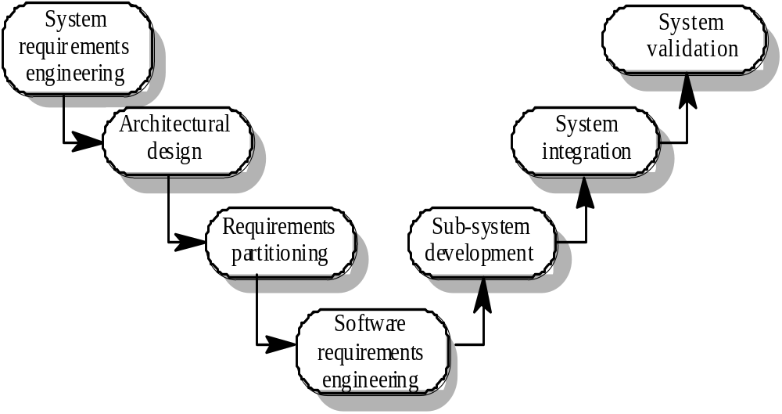
The systems engineering process
Monday, September 6, 2021

Slide 19
System engineering activities
System requirements engineering
  The requirements for the system as a whole are established and written to be understandable to all stakeholders
Architectural design
  The system is decomposed into sub-systems
Requirements partitioning
  Requirements are allocated to these sub-systems
Software requirements engineering
  More detailed system requirements are derived for the system software
Monday, September 6, 2021

Slide 20
System engineering activities
Sub-system development
  The hardware and software sub-systems are designed and implemented in parallel.
System integration
  The hardware and software sub-systems are put together to make up the system.
System validation
  The system is validated against its requirements.
Monday, September 6, 2021

Slide 21
Requirements document
The requirements document is a formal document used to communicate the requirements to customers, engineers and managers.
The requirements document describes:
  The services and functions which the system should provide
  The constraints under which the system must operate
  Overall properties of the system i.e.. constraints on the system’s emergent properties
  Definitions of other systems which the system must integrate with.
  Info. about the application domain (How to carry out specific task/computation).
  Constraints on the process.
Monday, September 6, 2021

Slide 22
Users of requirements documents
System customers
  specify the requirements and read them to check they meet their needs
Project managers
  Use the requirements document to plan a bid for system and to plan the system development process
System engineers
  Use the requirements to understand the system being developed
System test engineers
  Use the requirements to develop validation tests for the system
System maintenance engineers
  Use the requirements to help understand the system
Monday, September 6, 2021

Slide 23
Requirements document structure
IEEE/ANSI 830-1993 standard proposes a structure for software requirements documents
1. Introduction
  1.1 Purpose of requirements document
  1.2 Scope of the product
  1.3 Definitions, acronyms and abbreviations
  1.4 References
  1.5 Overview of the remainder of the document
Monday, September 6, 2021

Slide 24
Requirements document structure
2. General description
  2.1 Product perspective
  2.2 Product functions
  2.3 User characteristics
  2.4 General constraints
  2.5 Assumptions and dependencies
3. Specific requirements
  Covering functional, non-functional and interface requirements.
4. Appendices
5. Index
Monday, September 6, 2021

Slide 25
Adapting the standard
The IEEE standard is a generic standard which is intended apply to a wide range of requirements documents.
In general, not all parts of the standard are required for all requirements documents
Each organisation should adapt the standard depending on the type of systems it develops
Consider a company (XYZ) that develops scientific instruments
Monday, September 6, 2021

Slide 26
Organization XYZ standard
Preface
  This should define the expected readership of the document and describe its version history including a rationale for the creation of a new version and a summary of the changes made in each version.
Introduction
  This should define the product in which the software is embedded, its expected usage and present and overview of the functionality of the control software.
Glossary
  This should define all technical terms and abbreviations used in the document.
Monday, September 6, 2021

Slide 27
Organization XYZ standard
General user requirements
  This should define the system requirements from the perspective of the user of the system. These should be presented using a mixture of natural language and diagrams.
System architecture
  This chapter should present a high-level overview of the anticipated system architecture showing the distribution of functions across system modules. Architectural components which are to be reused should be highlighted.
Hardware specification
  This is an optional chapter specifying the hardware that the software is expected to control. It may be omitted if the standard instrument platform is used
Monday, September 6, 2021

Slide 28
Organization XYZ standard
Detailed software specification
  This is a detailed description of the functionality expected of the software of the system. It may include details of specific algorithms which should be used for computation. If a prototyping approach is to be used for development on the standard instrument platform, this chapter may be omitted.
Reliability and performance requirements
  This chapter should describe the reliability and performance requirements which are expected of the system. These should be related to the statement of user requirements in Chapter 4.
Monday, September 6, 2021

Slide 29
Organization XYZ standard
The following appendices may be included where appropriate:
  Hardware interface specification
  Software components which must be reused in the system implementation
  Data structure specification
  Data-flow models of the software system
  Detailed object models of the software system
Index
Monday, September 6, 2021

Slide 30
Writing essentials
Requirements are read more often than they are written. You should invest time to write readable and understandable requirements
Do not assume that all readers of the requirements have the same background and use the same terminology as you
Allow time for review, revision and re-drafting of the requirements document
Monday, September 6, 2021

Slide 31
Writing guidelines
Define standard templates for describing requirements
Use language simply consistently and concisely
Use diagrams appropriately
Supplement natural language with other description of requirements
Specify requirements quantitatively
Monday, September 6, 2021

Slide 32
Chapter review
Requirements define what the system should provide and define system constraints
Requirements problems lead to late delivery and change requests after the system is in use
Requirements engineering is concerned with eliciting, analyzing, and documenting the system requirements
The requirements document is the definitive specification of requirements for customers, engineers and managers.
The requirements document should include a system overview, glossary, statement of the functional requirements and the operational constraints
Monday, September 6, 2021

Slide 33
Exercises
Explain the problems which might arise if the following requirements were included in a requirements document for a library system:
  The system shall provide an easy-to-use graphical interface based on MS Windows XP. Accredited users should have privileged access to the cataloguing facilities of the system
  The system software shall be implemented using separated modules for cataloguing, user access and archiving.
List possible stakeholders for a library cataloguing systems
Suggest how the following requirements might be rewritten in a quantitative way
  The library system shall be easy-to-use.
  The library system shall provide reliable service to all classes of users.
  The library system shall provide a rapid response to all user requests for book information.
Monday, September 6, 2021

